Slide 1
Expense Tracker Software Design Specification
An overview of the design specification document.
April 9, 2024.

Slide 2
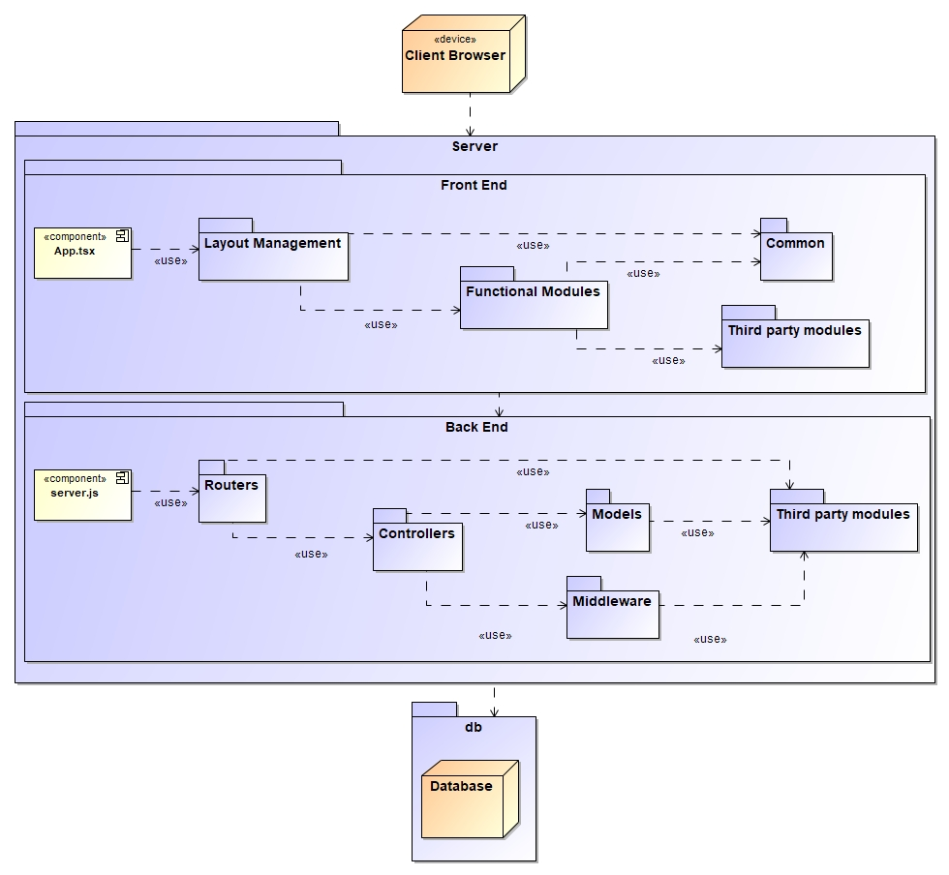
High-Level Architecture
Overview of Client-Server Architecture:
The Expense Tracker web application follows a typical client-server architecture model.
This architecture divides the application into two main components: the client-side front-end and the server-side back-end.
Front-End Development with ReactJS:
The front-end of the Expense Tracker is developed using ReactJS, a popular JavaScript library for building user interfaces.
ReactJS allows for the creation of dynamic and interactive UI components, providing a smooth user experience.
Back-End Development with ExpressJS:
The server-side back-end of the Expense Tracker is built using ExpressJS, a fast and minimalist web framework for Node.js.
ExpressJS simplifies the process of building robust web applications by providing a range of features and middleware for handling HTTP requests and responses.
Communication with the Database:
The back-end communicates with the database to store and retrieve data required by the application.
This communication is facilitated through the use of database query methods provided by Node.js modules such as mysql2 for MySQL databases.
The database stores essential information such as user profiles, transactions, categories, and budgets, enabling data persistence and retrieval.

Slide 3
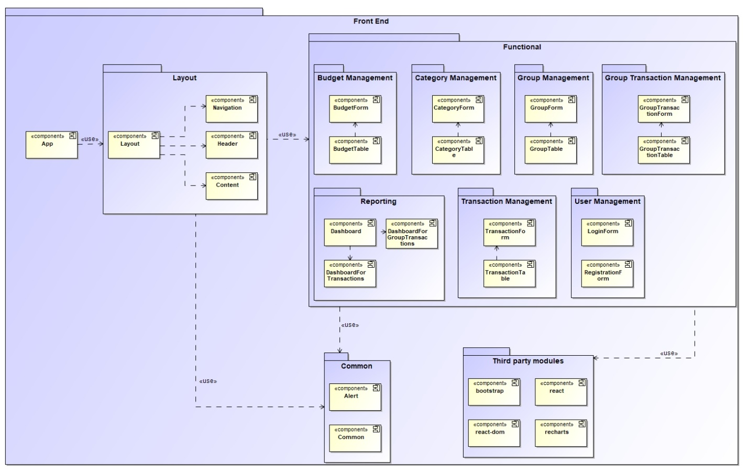
Low-Level Architecture - Front End
Detailed Architecture of Front-End Components:
The front-end architecture of the Expense Tracker application is structured into several key components, each serving specific purposes.
These components include Layout Management, Functional Modules, Common, and Third-party Modules, which collectively contribute to the overall functionality and user interface of the application.
Layout Management:
Responsible for managing the overall layout and structure of the user interface.
Includes sub-components such as Navigation, Header, and Content, which render different sections of the UI and ensure consistency in design.
Functional Modules:
Core components providing essential functionality to the application.
Includes modules for Budget Management, Category Management, Group Management, Transaction Management, Reporting, and User Management.
Each module contains sub-components responsible for specific tasks within its domain.

Slide 4
Low-Level Architecture - Front End
Common:
Contains shared functionality used across multiple modules.
Includes components such as Alert for displaying notifications and Common for shared utilities or services, enhancing code reusability and maintainability.
Third-Party Modules:
Integration of external libraries or modules into the application.
Includes modules like bootstrap for UI styling, react-dom for rendering React components on the DOM, and recharts for creating charts and visualizations, augmenting the application's capabilities.
Benefits of Modular Approach:
Reusability: Modular components can be reused across different parts of the application, reducing redundancy and promoting efficiency in development.
Maintainability: Modular architecture allows for easier maintenance and updates, as changes can be isolated to specific components without affecting the entire application.
Scalability: Modular design accommodates the addition of new features or modules, allowing the application to scale efficiently as requirements evolve.

Slide 5
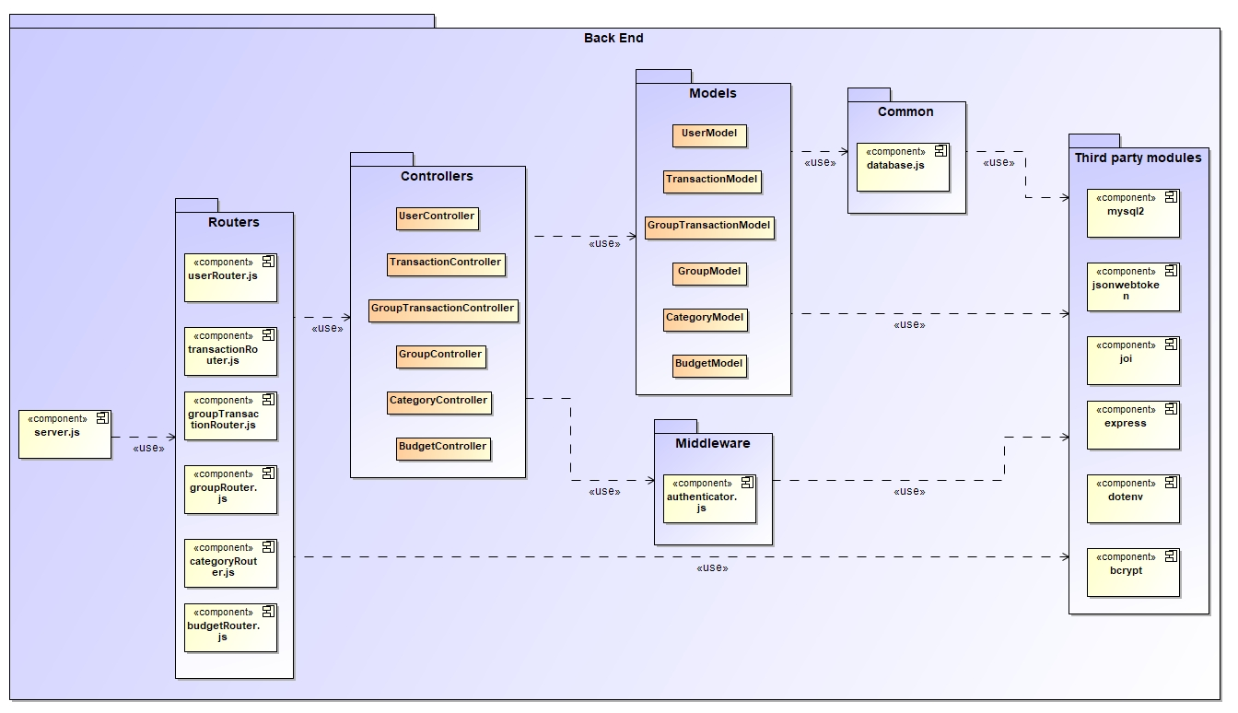
Low-Level Architecture - Back End
Detailed Architecture of Back-End Components:
The back-end architecture of the Expense Tracker application is structured into several key components, each serving specific roles in processing data and handling requests.
Routers:
Responsible for routing web service endpoints to corresponding controller functions.
Includes routers such as userRouter.js, transactionRouter.js, groupTransactionRouter.js, categoryRouter.js, and budgetRouter.js, each handling specific types of requests.
Controllers:
Manage HTTP request and response processing, serving as intermediaries between routers and models.
Includes controllers like UserController, TransactionController, GroupTransactionController, CategoryController, and BudgetController, each responsible for specific business logic.

Slide 6
Low-Level Architecture - Back End
Models:
Responsible for communicating with the database to fetch or modify data, encapsulating the business logic and data access operations.
Includes models such as UserModel, TransactionModel, GroupTransactionModel, CategoryModel, and BudgetModel, representing different entities and data structures.
Middleware:
Software components that bridge different systems or components within the application, providing additional functionality or processing.
Includes middleware like authenticate.js, responsible for authentication and authorization of requests, ensuring security and access control.
Third-Party Modules:
Integration of external libraries or modules into the application to enhance functionality or provide utilities.
Includes modules such as mysql2 for database communication, jsonwebtoken for authentication, bcryptjs for password hashing, express for web server setup, joi for request validation, and dotenv for environment configuration.

Slide 7
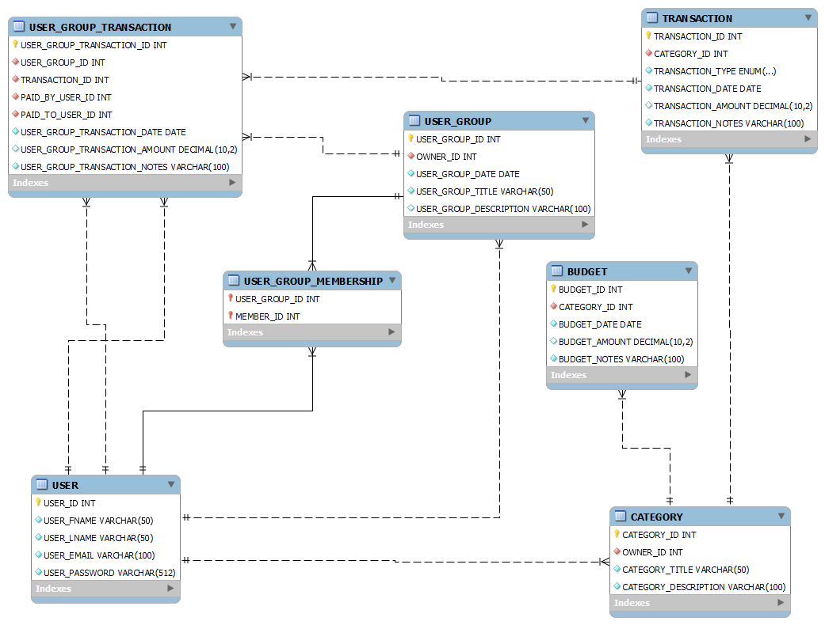
Database Design
Entity Relationship Diagram (ERD) Overview:
The Expense Tracker application's database design is visualized through an Entity Relationship Diagram (ERD), providing a comprehensive overview of the data model and its relationships.
The ERD illustrates the structure of the database, including entities, attributes, and the connections between them.
Business Rules and Relationships Depicted:
The ERD reflects the business rules and constraints of the Expense Tracker application, ensuring that the database schema aligns with the application's requirements.
Relationships between entities are depicted, indicating associations such as one-to-one, one-to-many, or many-to-many, as dictated by the business logic.
Importance of Adherence to Business Rules and Data Integrity:
Adherence to business rules ensures that the database accurately represents the real-world relationships and operations of the Expense Tracker application.
Maintaining data integrity is crucial for the reliability and consistency of the application, preventing anomalies and errors in data management.
The ERD serves as a blueprint for developers, guiding the implementation of the database schema and ensuring consistency across the application's data model.

Slide 8
Front End Mockups
Visual Representations of User Interface Design:
Front End Mockups provide visual representations of the Expense Tracker application's user interface design, offering insights into the look and feel of the application.
Screens for various functionalities, including registration, login, dashboard, categories, budgets, transactions, groups, and group transactions, are showcased to give a holistic view of the user experience.
Screens for Different Functionalities:
Registration Screen: Allows users to create an account with the Expense Tracker application, providing necessary details.
Login Screen: Enables users to log in to their existing accounts securely.
Dashboard: Offers an overview of financial transactions and activities, providing insights through charts and visualizations.
Categories, Budgets, Transactions, Groups, Group Transactions Screens: Provide interfaces for managing different aspects of financial data, such as creating, editing, and deleting categories, budgets, transactions, groups, and group transactions.
Importance of User Experience and Intuitive Design:
User experience (UX) plays a crucial role in the success of an application, influencing user satisfaction and engagement.
Intuitive design ensures that users can easily navigate through the application, perform tasks efficiently, and understand the functionalities without encountering confusion or frustration.
Front End Mockups serve as a visual guide for developers and designers, aligning their efforts to create an engaging and user-friendly interface for the Expense Tracker application.

Slide 9
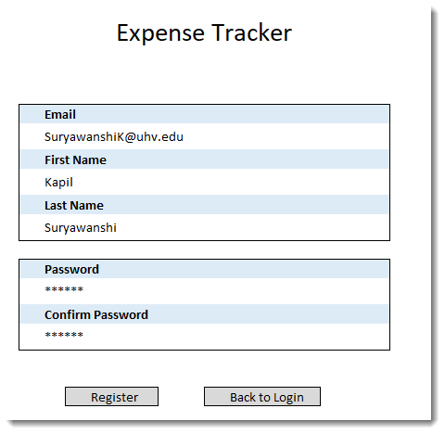
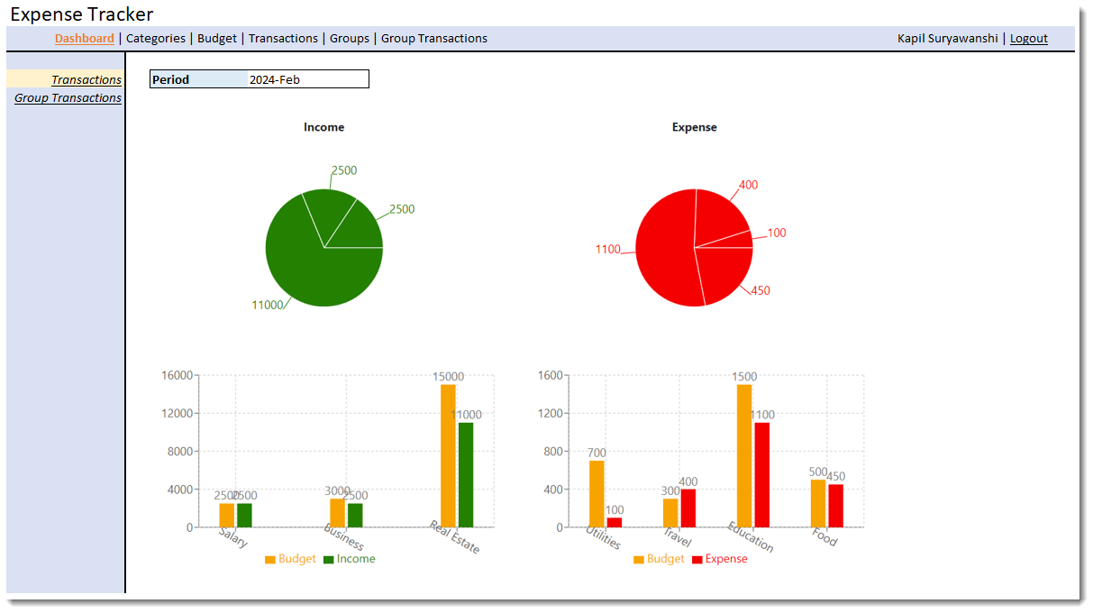
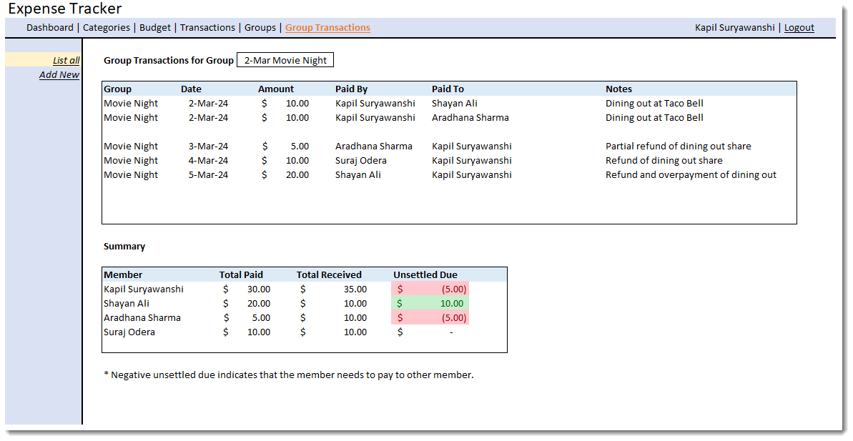
Front End Mockups

Slide 10
Detailed Design - Front End
UML Component Diagram: Front-End Design
The UML Component diagram provides an overview of the front-end design architecture for the Expense Tracker application.
Components, dependencies, attributes, operations, and receptions are illustrated to depict the structure and interactions within the front-end system.
Key Components and Their Responsibilities:
App Component: Acts as the entry point of the front end, initiating the single-page JavaScript application.
Layout Component: Manages the overall layout and structure of the user interface, including Navigation, Header, and Content components.
Functional Components: Handle core application logic and user interactions, such as Budget Management, Category Management, Transaction Management, Group Management, and Reporting.
Common Component: Contains shared functionality used across multiple modules, such as Alert for notifications and Common for utilities or services.
Third-Party Modules: External libraries or modules integrated into the application for additional functionality, such as bootstrap for UI styling and recharts for creating charts and visualizations.
Interactions and Responsibilities:
Components interact with each other through dependencies, with arrows indicating the direction of interaction.
Attributes represent state variables, while operations depict functions that accomplish specific tasks within each component.
Receptions denote event handlers owned by the component, facilitating the handling of user events and actions.
The architecture follows a modular approach, promoting code reusability, maintainability, and scalability in the front-end development process.

Slide 11
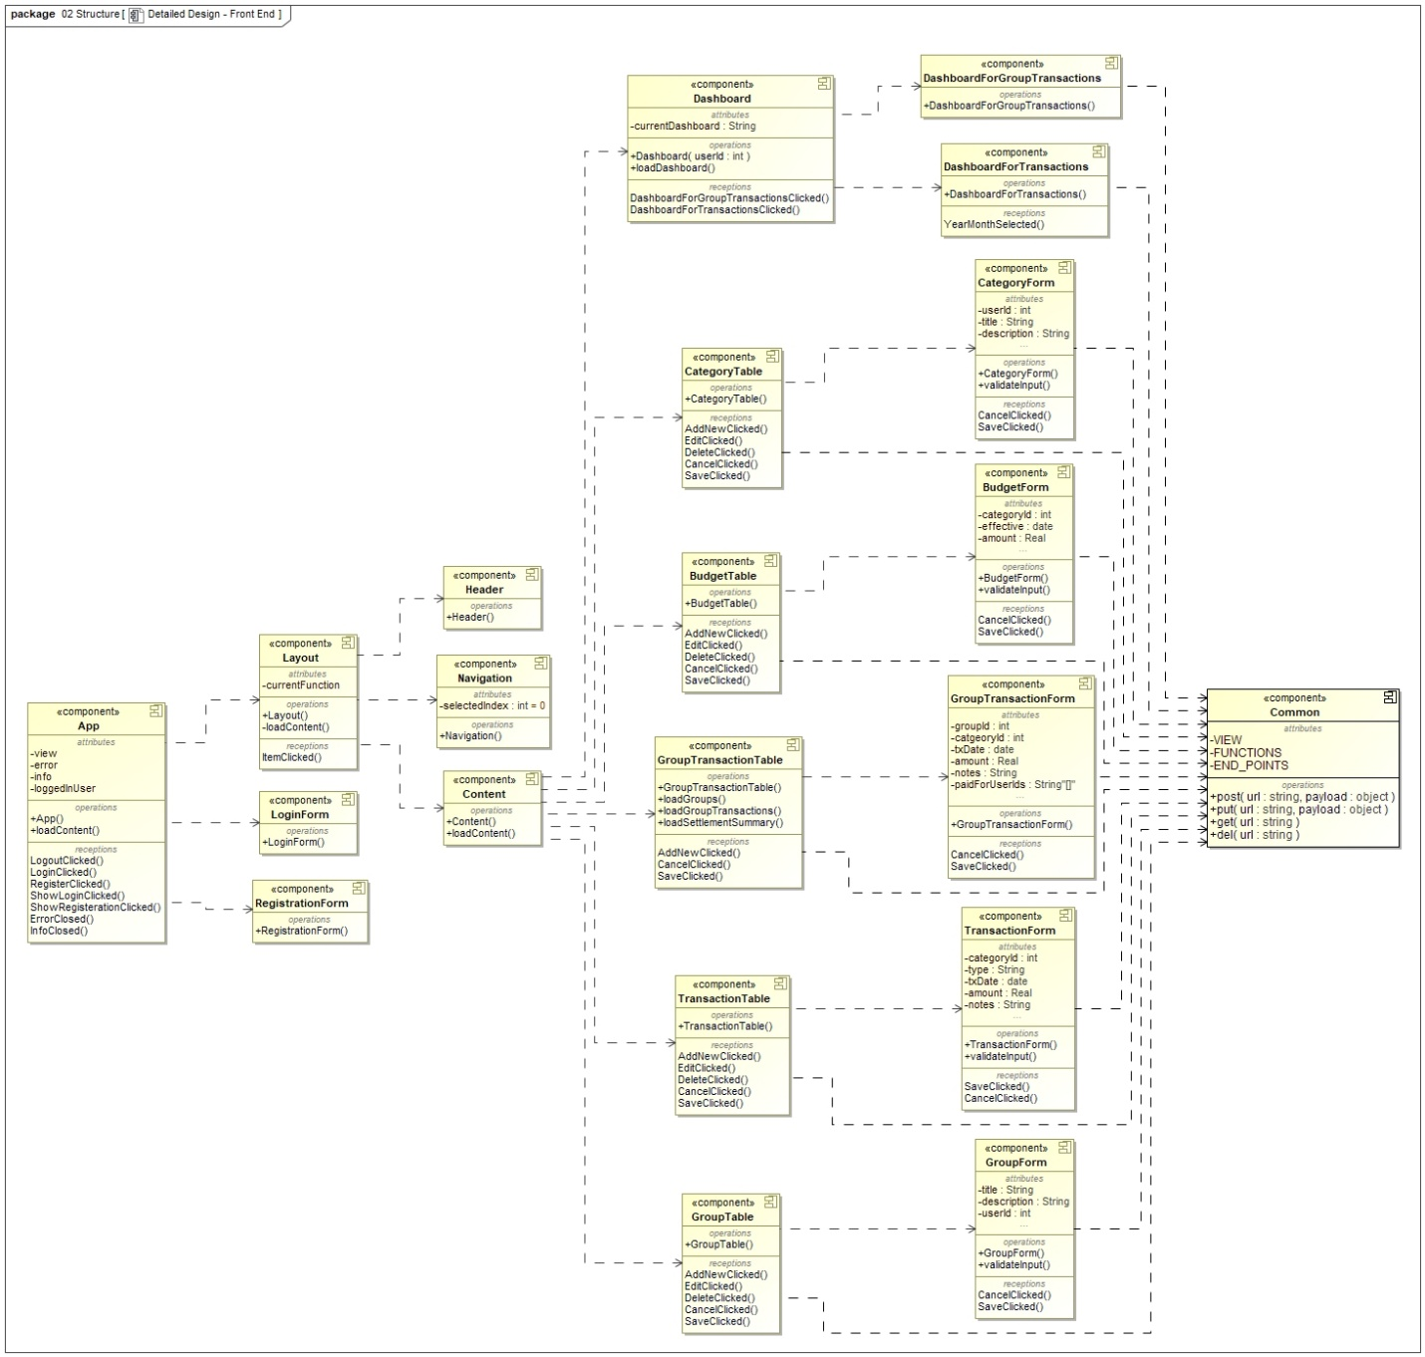
UML Frontend Component diagram

Slide 12
Detailed Design - Back End
UML Component Diagram: Back-End Design
The UML Component diagram provides an in-depth view of the back-end design architecture for the Expense Tracker application.
Classes, dependencies, service patterns, and third-party modules are illustrated to depict the structure and interactions within the back-end system.
Key Components and Their Responsibilities:
Routers: Handle routing of web service endpoints to corresponding controller functions.
Controllers: Manage HTTP request and response processing, invoking appropriate actions and delegating tasks to models.
Models: Communicate with the database to fetch or modify data, encapsulating business logic and data operations.
Middleware: Bridge different systems or components within the application, such as authentication and authorization middleware.
Third-Party Modules: External libraries integrated into the application for additional functionality, such as database communication, authentication, and configuration.
Layered Architecture and Data Flow:
The back-end architecture follows a layered approach, with routers, controllers, and models forming distinct layers responsible for different aspects of application logic and data management.
Service patterns, including getAll, getById, create, update, and delete, are implemented by controllers and models to perform CRUD operations on data entities.
Dependencies between classes facilitate data flow and communication within the back-end system, ensuring seamless execution of business logic and data processing tasks.

Slide 13
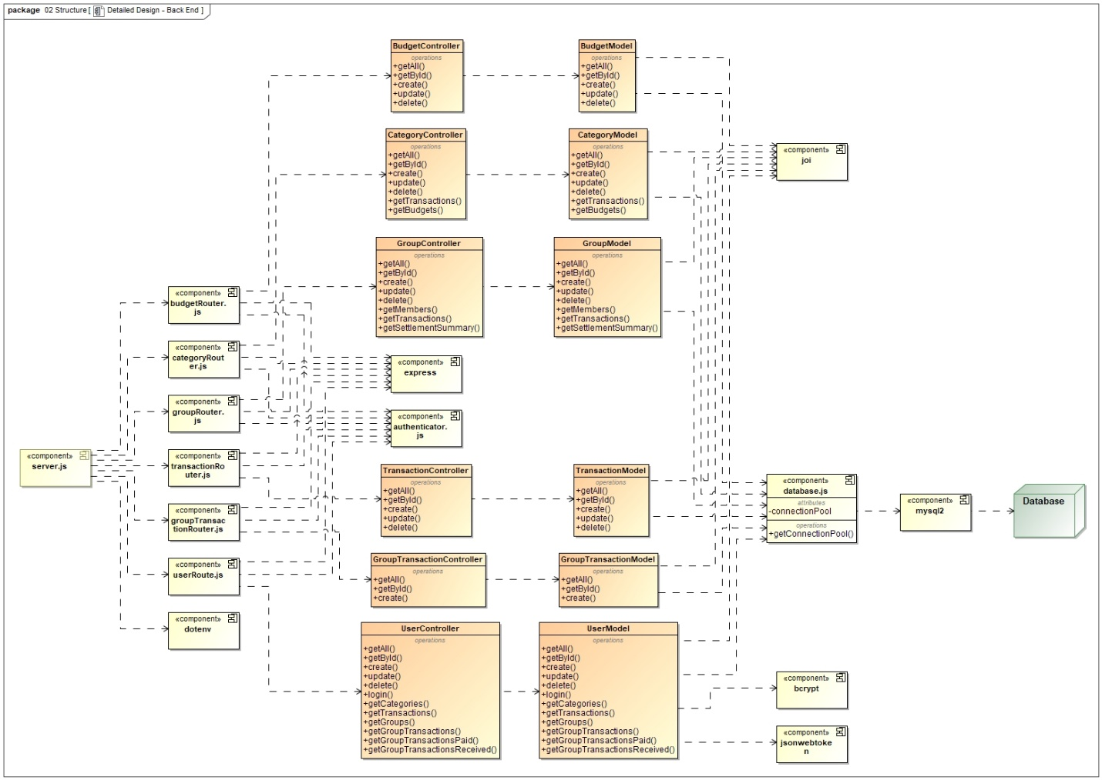
UML Backend Component diagram

Slide 14
Activity Diagrams Overview
Activity Diagrams: Visualizing System Processes
Activity diagrams serve as graphical representations of system processes, depicting the flow of actions and interactions within the Expense Tracker application.
These diagrams provide a comprehensive overview of various scenarios, including creating, editing, viewing, and deleting transaction categories, offering insights into the sequence of steps and interactions involved in each process.
Scenarios Covered:
Create Transaction Category: Illustrates the process of creating a new transaction category within the application, from user initiation to database update.
Edit Transaction Category: Demonstrates how users can edit existing transaction categories, including data retrieval, modification, and database update.
View Transaction Categories: Shows how users can view their transaction categories, highlighting the retrieval of category data from the database and its presentation to the user interface.
Delete Transaction Category: Depicts the process of deleting transaction categories, including user request handling, database operations, and response management.
Importance of Activity Diagrams:
Activity diagrams provide a visual representation of system processes, aiding in understanding the flow of actions and interactions between system components.
By visually depicting each scenario, activity diagrams help stakeholders grasp the functionality and logic behind different features of the Expense Tracker application.
These diagrams serve as valuable documentation for developers, testers, and other team members, facilitating communication and collaboration during the development and testing phases.

Slide 15
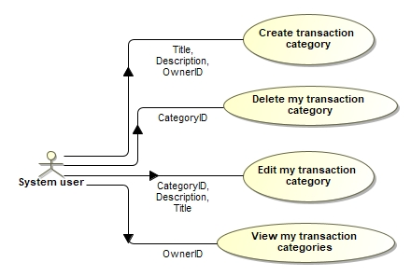
Activity Diagrams: Category management use cases

Slide 16
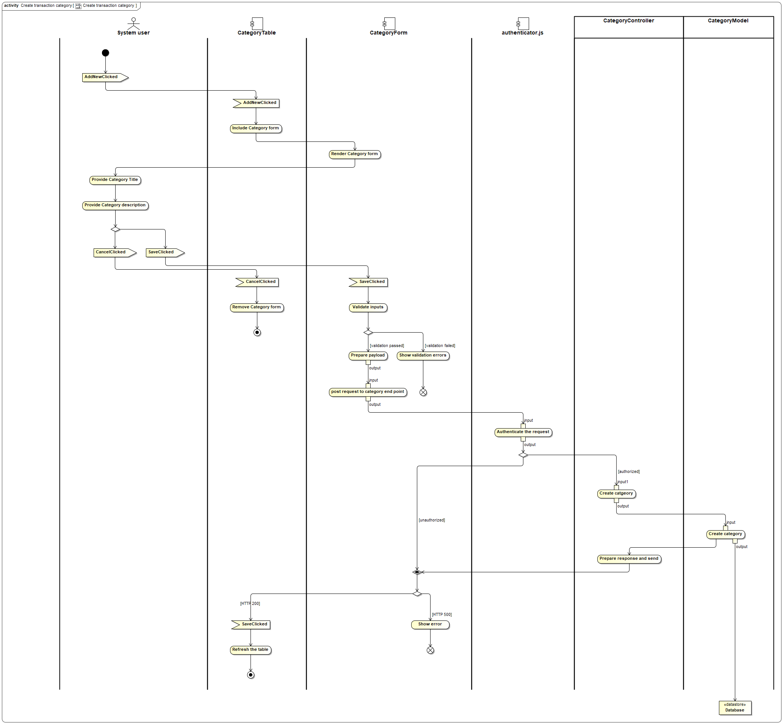
Activity Diagram - Create Transaction Category

Slide 17
Activity Diagram - Create Transaction Category
Description: This activity diagram illustrates the process of creating a new transaction category within the Expense Tracker application. It outlines the sequential steps involved, from user initiation to the final database update.
Steps Involved:
System User:** Generates the "AddNewClicked" event to initiate the creation of a new transaction category.
CategoryTable:** Handles the "AddNewClicked" event and includes the CategoryForm component for data entry.
CategoryForm:** Renders the category form and awaits user input for category title and description.
System User:** Provides the necessary input by entering the category title and description.
CategoryForm:** Handles the "SaveClicked" event triggered by the user and proceeds to validate the input data.
CategoryForm:** If input validation fails, the form displays an error message and waits for corrected input. If validation passes, it prepares the payload and sends a request to the category web service endpoint.
Authenticator.js:** Authenticates the incoming request and forwards it to the CategoryController if authorized.
CategoryController:** Accepts the payload, validates the data, and delegates the operation to the CategoryModel.
CategoryModel:** Creates the new category record in the database and reports the operation status back to the CategoryController.
CategoryController:** Prepares the appropriate HTTP response (200 for success, 500 for failure) and sends it back to the CategoryForm.
CategoryForm:** If the response indicates success, it communicates with the parent component (CategoryTable) to conclude the operation and update the UI.
Importance:
This activity diagram provides a detailed breakdown of the steps involved in creating a transaction category, elucidating the interactions between different components within the system.
By understanding each component's role and the sequence of actions, developers and stakeholders gain insights into the application's behavior and functionality during category creation.
Clear documentation of the creation process facilitates efficient development, testing, and troubleshooting, ensuring smooth user interactions and data integrity within the Expense Tracker application.

Slide 18

Thank you

